Slide 1
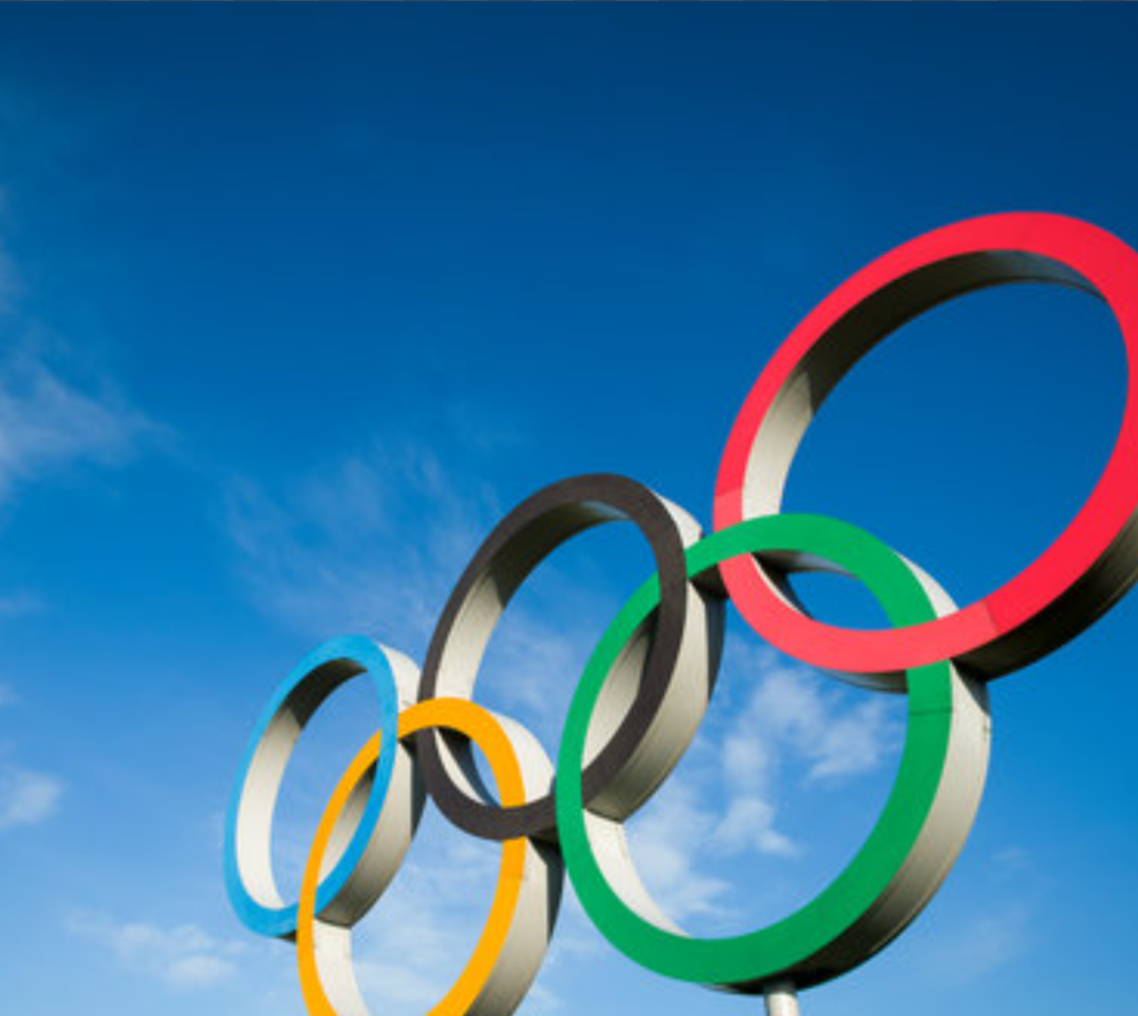

Capstone Project
120 Years of Grandeur: Unveiling Trends and Insights in Olympic data
Data Analysis on Olympics

Slide 2
MEET OUR TEAM
STRATEGY STARS
HITHA CHOUDHARY G - 22BTRAD015
K SHREESHANTH - 22BTRAD017
LAKSHYA SHARMA - 22BTRAD021

Slide 3

Agenda
1 | Introduction
2 | Overview of the Dataset
3 | Objectives
4 | Approach
5 | Insights Gained
6 | Challenges Faced
7 | Connect with us

Slide 4
Introduction
“THE OLYMPICS”
THE OLYMPICS BRING TOGETHER ATHLETES FROM ALL OVER THE WORLD, SHOWCASING PEAK HUMAN PERFORMANCE AND FOSTERING INTERNATIONAL UNITY. ALSO, DID YOU KNOW THAT SWIMMING IS THE MOST MEDALED SPORT IN OLYMPIC HISTORY? WELL, YES IT IS AND IN ORDER TO GAIN MORE SUCH VALUABLE INSIGHTS LET'S DIVE INTO ANALYZING DATA FROM PAST GAMES, AND TAKE A SNEAK PEAK INTO THE ATHLETE'S PERFORMANCE, SPORTING TRENDS, AND THE EVOLUTION OF THE OLYMPICS.

Slide 5

OVERVIEW OF
THE DATASET
This dataset, which covers the first modern Olympics up until 2016, provides a special prism through which we may examine a variety of sporting, cultural, and historical themes.
1
Key features includes basic information about the athletes ("ID", "Name", "Sex", etc.) and their physical attributes("Height", "Weight", etc.)
2
Features like "Medal", "Team", "Sport", "region", "Season" are a few of the intriguing attributes that draw attention to our analysis.
3

Slide 6





OBJECTIVES
Focusing on athlete participation in the Olympics, including the rise of female athletes, and how the age distribution of athletes varies across sports and Games.
Delving into the world of Olympic medals. We'll look at the overall medal count, how medals are distributed across different Games and sports, and which countries reign supreme.
Explores the Olympic sporting landscape: variety of sports, popularity based on participation, and trends across Games to identify emerging or declining sports.
Differences between Summer and Winter Olympics. We'll compare participation, medal distribution, popular sports, and even age and physical attributes of athletes in each category.
Predicting Athlete’s physical attributes based on a Sport and exploring links between a country's social/economic factors and Olympic success.
Athlete Participation & Demographics
Medal Distribution
Trends in Sports
Summer vs Winter
Deeper Dives

Slide 7
APPROACH
Acquire dataset and understand its structure and summary statistics.
Stage 1
Address errors, inconsistencies, and missing values in the data. Making sure the data is prepared for analysis, format it correctly (data types) as needed.
Each stage was completed using different Python libraries, such as numpy and pandas, and visualization tools, like matplotlib, seaborn, and plotly.
Stage 2
Stage 5
Identifying important patterns, correlations, and trends in the data and creating clear, informative visuals to effectively convey our conclusions and observations
Stage 3
The previously stated goals were kept in mind as the analysis and visualizations were completed step by step.
Stage 4

Slide 8
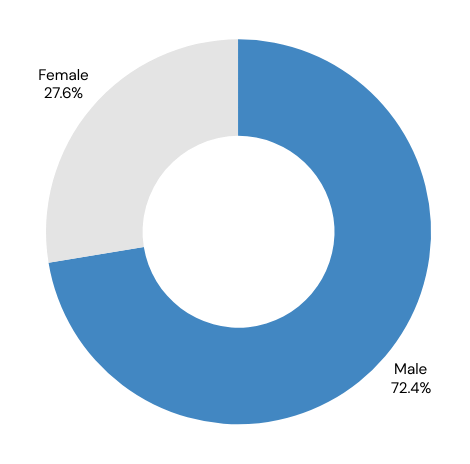
INSIGHTS GAINED
What is the Athlete Participation per Olympic year?
Year with highest participants: 2000, 13.8k participants
Year with lowest participants: 1896, 380 participants
Analysis by Participation
What is the proportion of Male vs Female participation & did it increase over time?
Male Participation: 72.4%, Female Participation: 27.6%
From our insights we can say that Female participation increased dramatically, and this trend started during the Cold War period (1945-1991).
The Olympic Games were canceled in 1916, 1940, and 1944. Were these cancellations connected to any historical events?
It was found that the Olympics was cancelled during 1916, 1940 and 1944 due to World War I and World War II.
This signifies how historical data also plays a role in identifying patterns and trends.

Slide 9

Analysis by Age
What is the age dynamics across Sports?
The age range for the top sports is found to be between 20 and 30 years old.
The older age groups are observed to be participating in sports that require more mental strength.
What is the influence of age on medal type?
Majority of medalists aged between 20 and 27, indicating peak performance years.
Analysis by Medal
What is the Medal Distribution by country?
The United States, Russia, and Germany are the nations with the most number of medals in each category. Southeast Asia, Africa, and the Northwest parts of South America consistently have the fewest medals.
What is the distribution of medals by each year and sport?
Medals surged after the 1960s, with some dips. Athletics reigns supreme, followed by swimming and rugby.
What is the distribution of medals for each Gender?
Although men have won significantly more medals than women in every category, when taking into account the participation ratio of men to women, women still have an equal contribution.

Slide 10

Analysis by Sport
What are the most popular sports by participation?
Athletics, Gymnastics, Swimming- Global
Hockey, Athletics, Shooting -India
What is the correlation of height and weight for each sport?
High Correlation: Rugby Sevens, Gymnastics and Triathlons.
Low Correlation: Tug-of-War and Ski Jumping.
What is most and least played sport by women over the years?
Preferred Sports: Gymnastics, Swimming, and Athletics.
Less Preferred Sports: Motorboating, Croquet, and Alpinism.
Analysis by Season
What is the number of sports played by each edition?
Up until 1992 summer and winter Olympics were being played in the same year, which further on was played in different years
Popular sport per edition based on Athlete participation
Summer: Athletics, Gymnastics, and Swimming.
Winter: Cross Country Skiing and Alpine Skiing.
Which countries participated most in each of the seasons?
Summer Olympics: Italy, France, USA, Canada
Winter Olympics: Poland, Sweden, France, Norway

Slide 11

Social Factors
What are the countries having the best male female ratio?
Countries like China, Guinea-Bissau, Marshall Islands, North Korea and Palau place the highest in sending equal number of participants with respect to gender.
Does hosting the Olympics improve Performance?
Results imply that, although serving as the host nation can boost performance, it is not guaranteed to win the most medals. Geopolitical, social, and economic factors,play crucial roles in a nation's Olympic success.
What is the gender distribution in top countries
Even if the number of women participating has grown over time, leading nations like the USA and Japan can send in a higher number of female participants, setting an example for society.
Predictive Analysis
We created a model for medal tally prediction which considers features such as GDP of the country, population and home field advantage.
We even attempted to predict the sport an athlete plays using just height and weight.
We made the predictions for two random sports weightlifting and athletics where we thought height and weight factors come into play a lot.

Slide 12
CHALLENGES FACED
1
2
3
4
DATA CLEANING
DATA COMPLEXITY
TEMPORAL DISCONTINUITY
INTERPRETATION COMPLEXITY
Managing and analyzing large and complex data is challenging as it requires careful choice of computational techniques.
The intermittent occurrence of Olympics introduces challenges in trend identification.
Interpreting Olympic data requires understanding sports dynamics, historical events, and sociopolitical factors, which can be complex.
Choosing the right imputation method to fill in the missing values and handling duplicate values

Slide 13

Connect with us
HITHA CHOUDHARY G - HTTPS://WWW.LINKEDIN.COM/IN/HITHA-CHOUDHARY-G-7345372A3/
K SHREESHANTH - HTTPS://WWW.LINKEDIN.COM/IN/K-SHREESANTH-GOUDA-654537253/
LAKSHYA SHARMA - HTTPS://WWW.LINKEDIN.COM/IN/LAKSHYASHARMA97/
GROUP GITHUB REPO:
HTTPS://GITHUB.COM/HITHACHOUDHARY/FUTURENSE-INTERNSHIP-CAPSTONE-PROJECT

Slide 14
Thank you!
INSIGHTS HELP IN MAKING DATA-DRIVEN DECISIONS. HERE'S TO MORE EXPLORING, LEARNING, AND UNLOCKING THE SECRETS HIDDEN WITHIN THE DATA AROUND US!!!
By Team:
Strategy Stars

